Slide 1

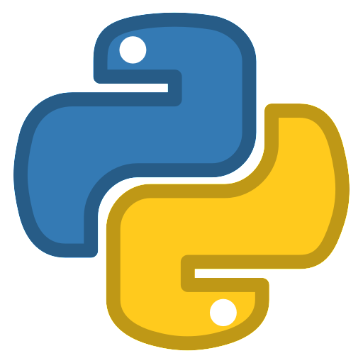
Importing modules and demonstrating libraries

Slide 2
Recap!
We should know how to…
Understand how classes and inheritance work
Know how to open, read, write, and close files

Slide 3
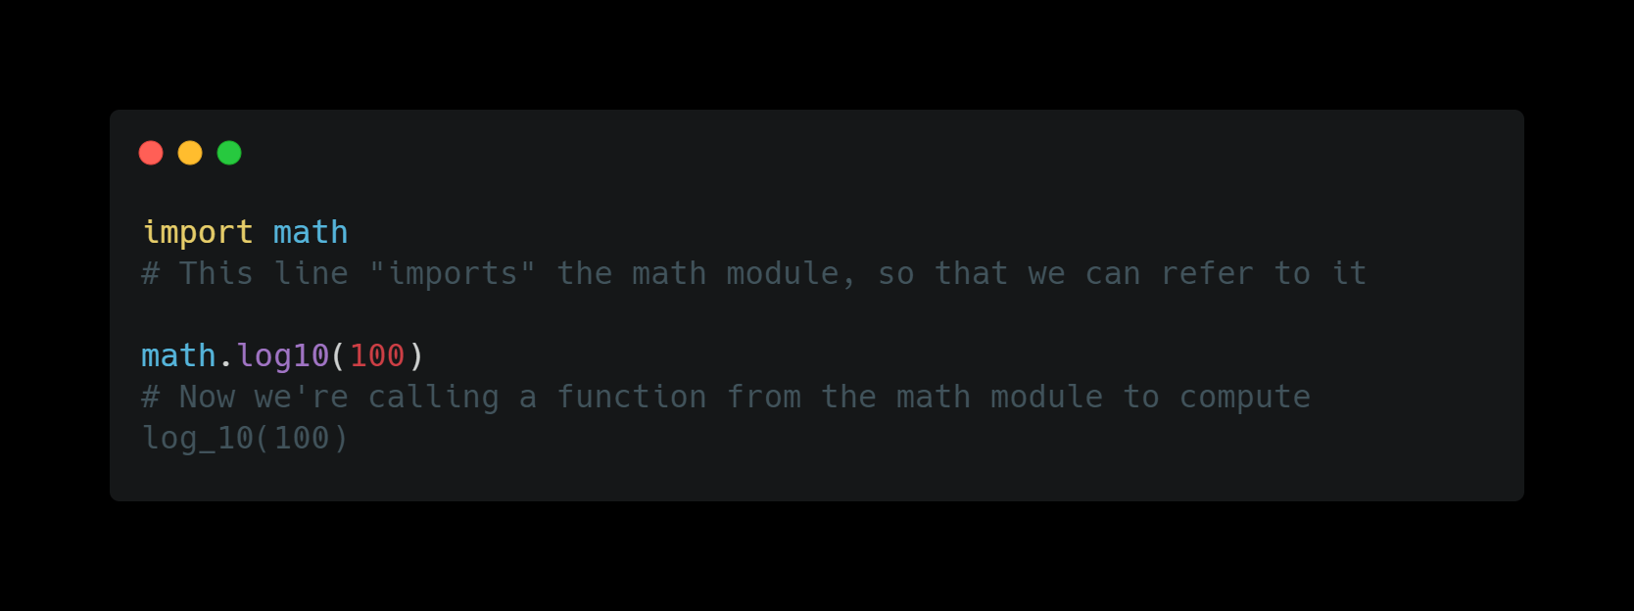
modules
A module is a file/files that contains python code
Those files may contain functions that can be imported for your own use
In general, the python standard library already provides a lot of useful modules for all sorts of things
Must use the import keyword when importing a library

Slide 4
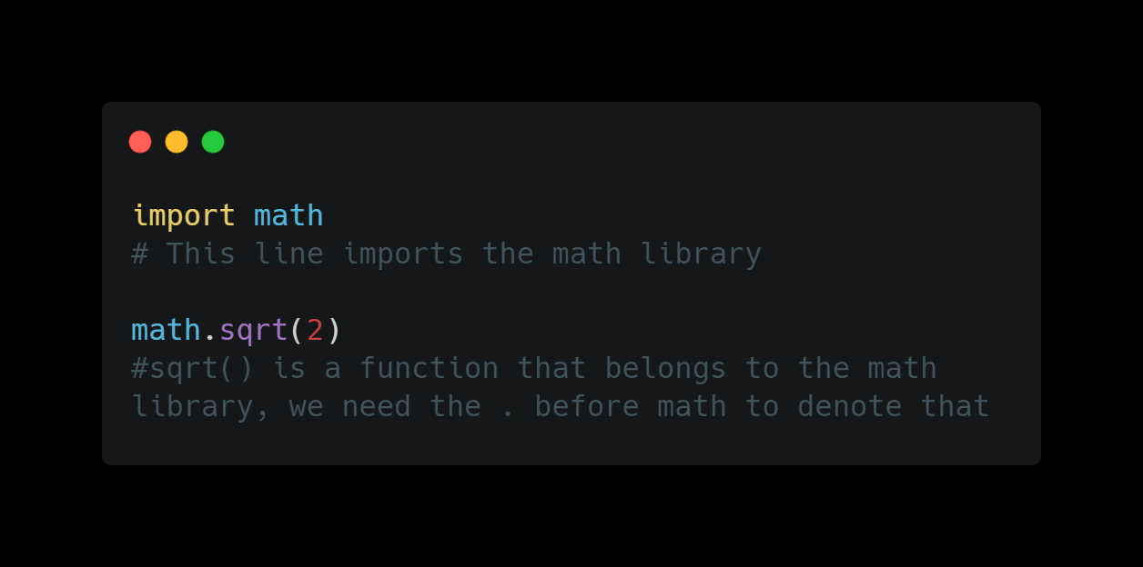
Dot notation
It is used when organizing hierarchy in classes, modules, and functions
If you want to use a function from a module, you would always need the ‘.’notation

Slide 5
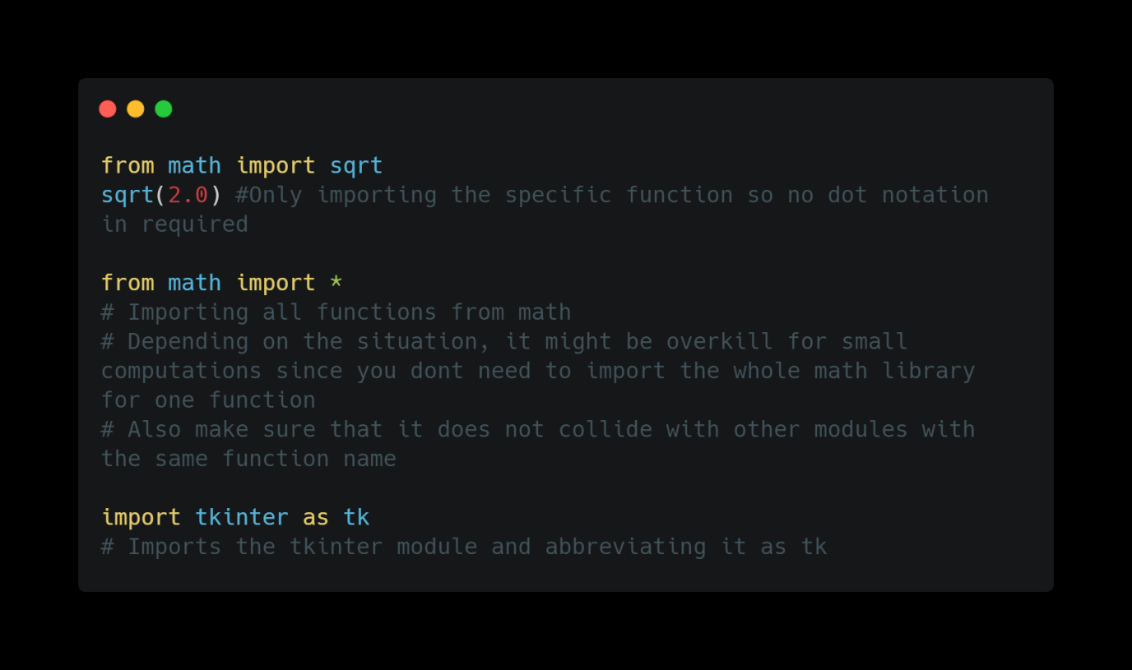
More about import
If you only want to use a specific function in a module, then you can import it using from <module> import <function>
You can also abbreviate the function name if its too long

Slide 6
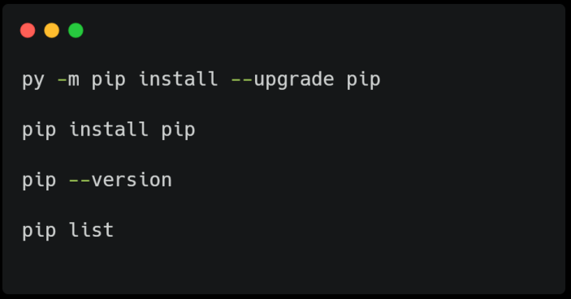
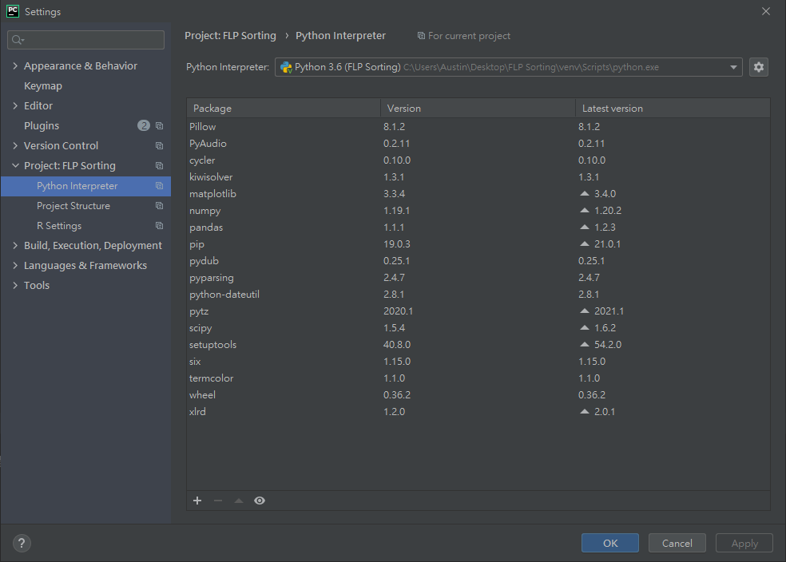
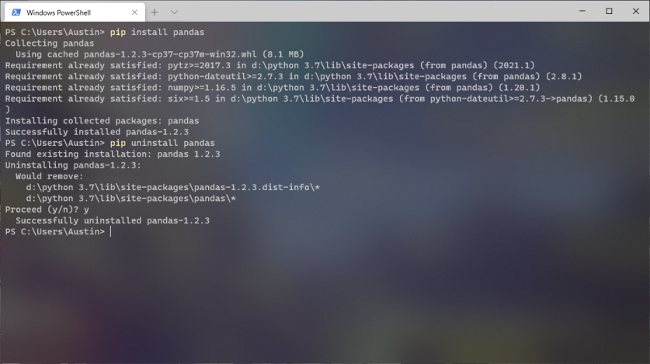
How to install modules outside the standard ones?
There are a myriad of libraries out there for you to explore and use
If you are on pycharm, ctrl + alt + s allows you to view and add/ remove modules
If you want to install it natively on your pc, you can use pip to install (should come with python 3.4+)

Slide 7
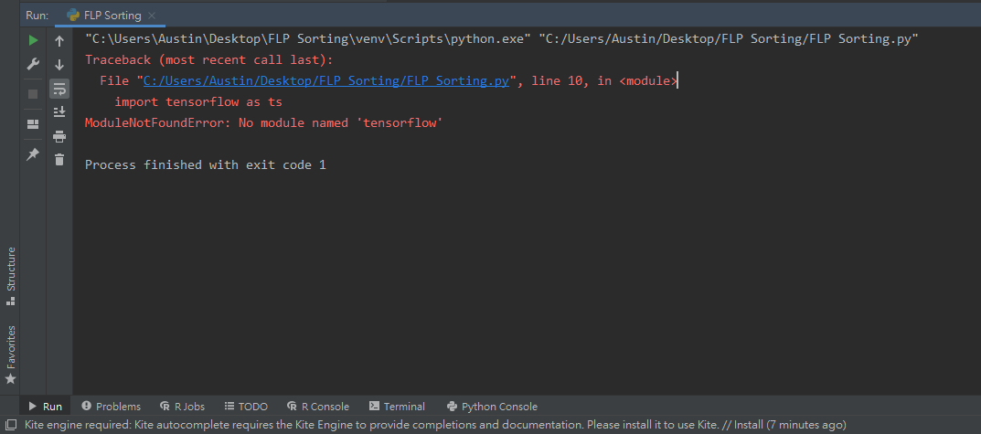
What happens when a module isn’t installed?
A ModuleNotFoundError will occur if a module isn’t installed when the program specifies it
To fix it, just install the module that it needs

Slide 8
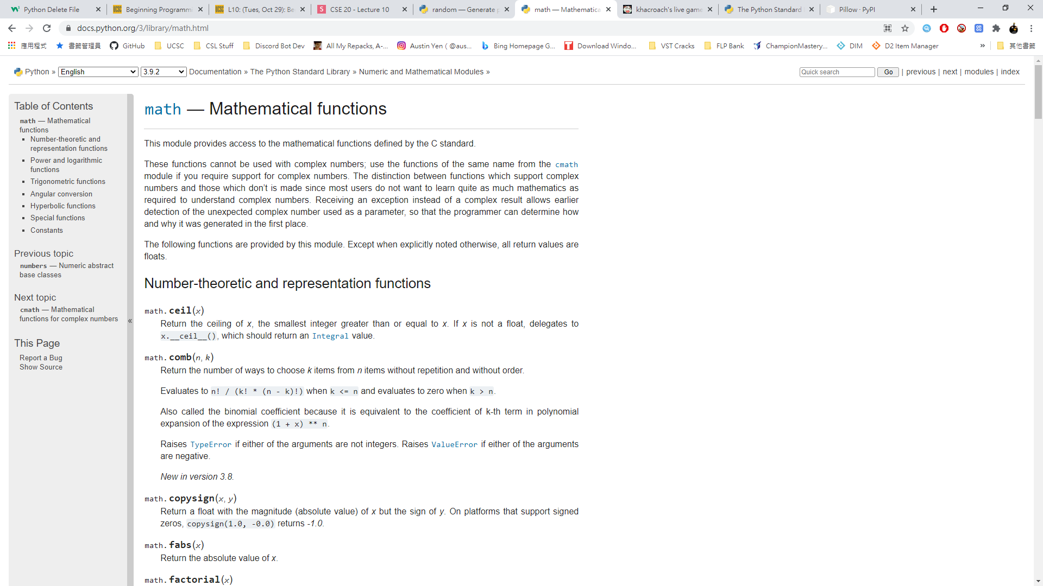
How to know what a module works?
All modules are built differently so knowing how to read the documentation is important when understanding how a module works

Slide 9
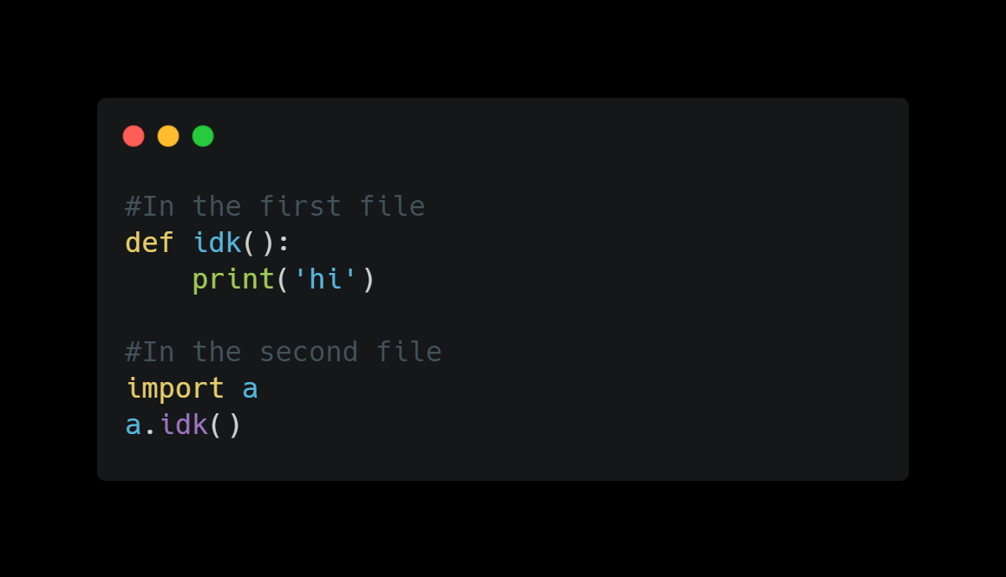
Calling files from another python file
You can write your own modules!
Create a file and import the file you created on top of the second file (show corona project)
Great way when collaborating with other people

Slide 10
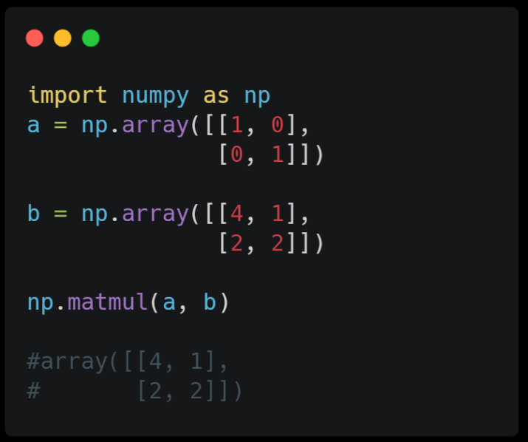
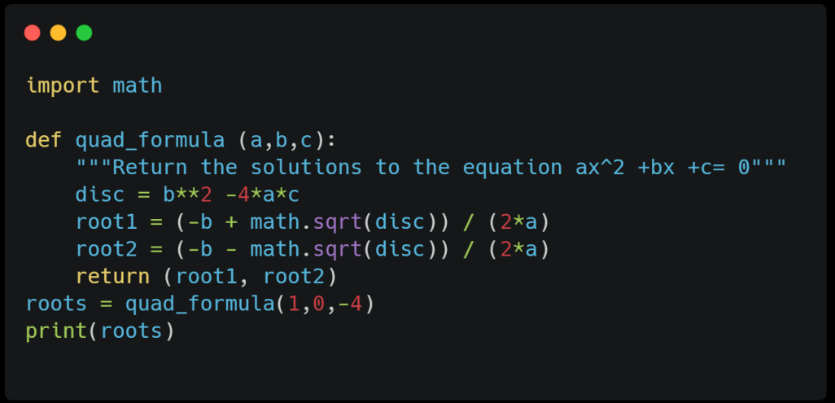
Module examples:
Math & numpy
Math is a built in library in python
Numpy is an external library, it performs most thing that math does but in addition, it is used to perform math on arrays such as vector calculus or linear algebra
Use math to keep your program lightweight

Slide 11
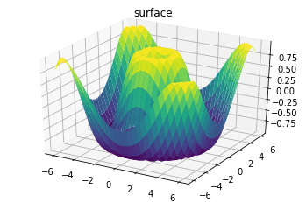
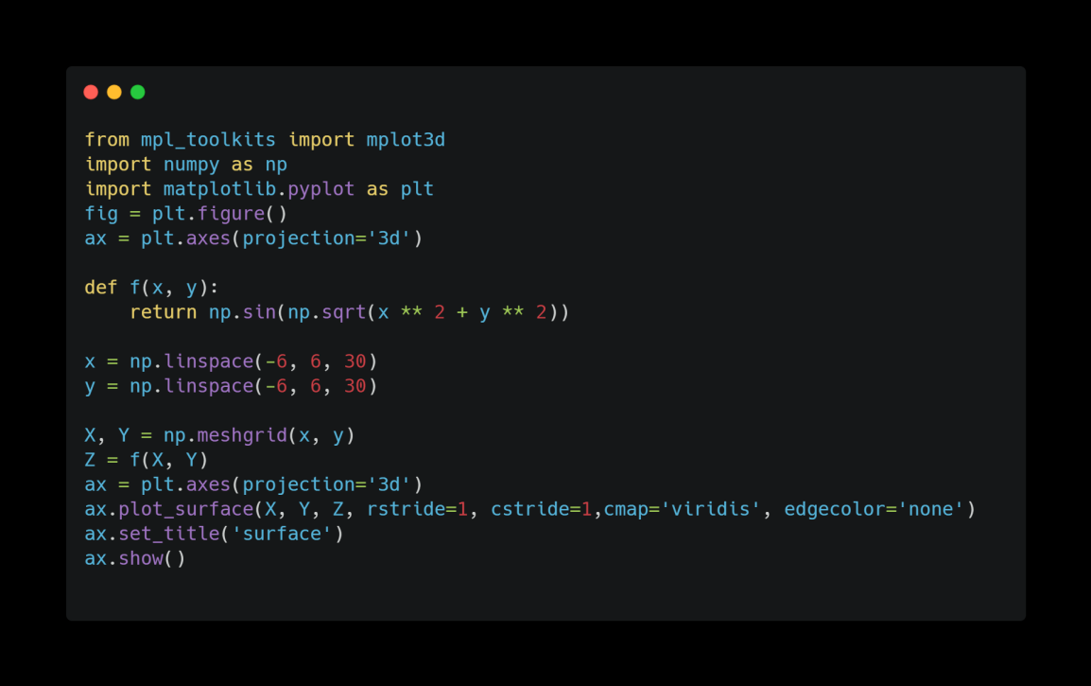
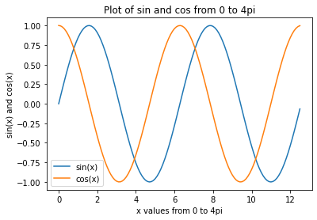
Module examples:
mathplotlib
Used to plot graphs
Can also plot in 3D as well!

Slide 12
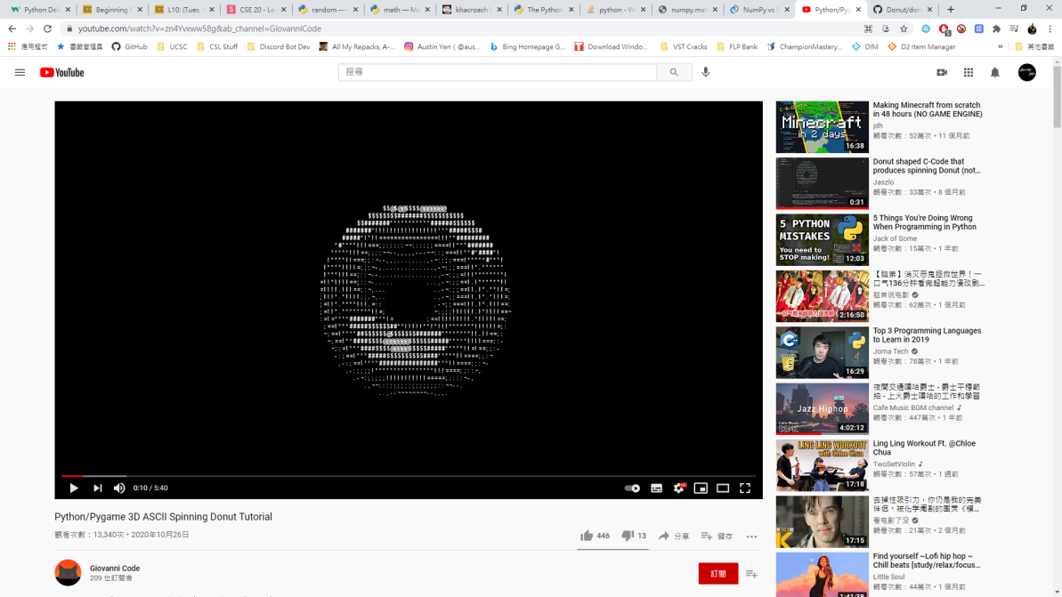
Module examples:
pygame
Used to create games/ animations
https://www.youtube.com/watch?v=zn4Yvxww58g&ab_channel=GiovanniCode

Slide 13
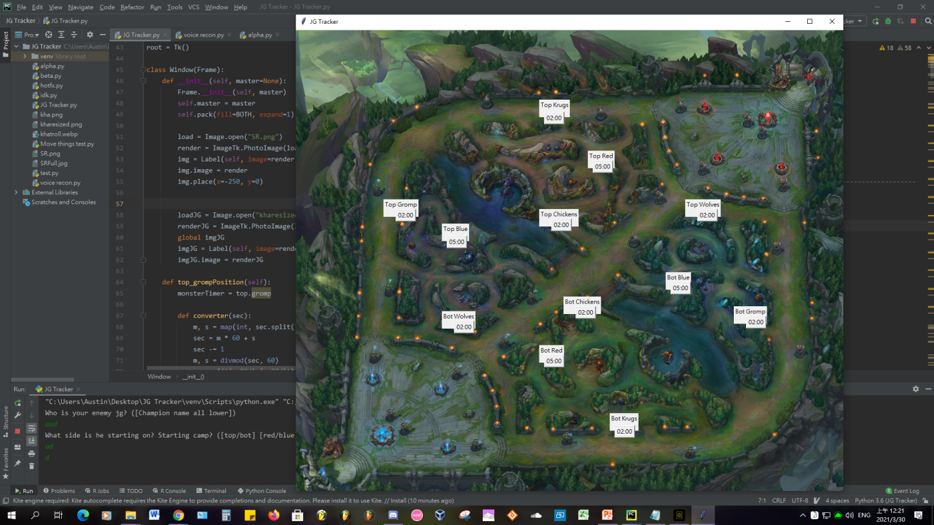
Module examples:
tkinter & PIL
Tkinter is used to create the graphical interface (GUI)
Pil is used for dealing with image processing

Slide 14
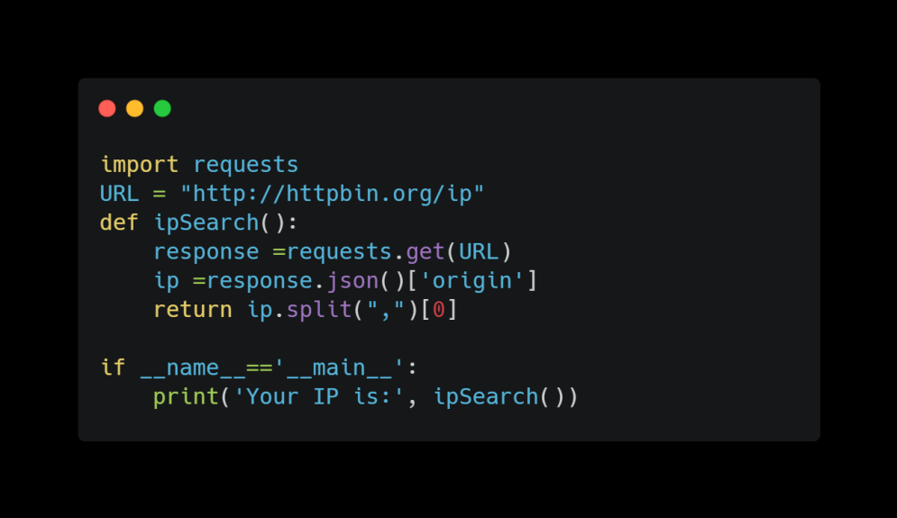
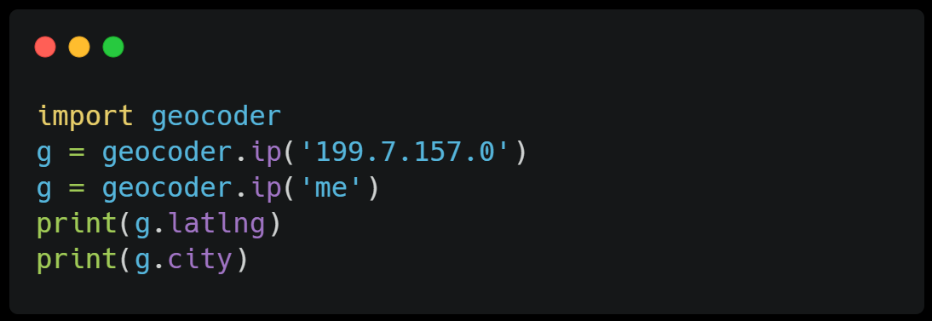
Module examples:
Requests & geocoder?
Requests allows you to take data from a web link
Geocode can return your current location through IP address or your GPS (lat/long)

Slide 15
There are more modules for you to try out!
The modules shown previously are only a few popular ones
There are way more modules out there!
PyAudio: digital audio manipulation
Tensorflow/pytorch: AI/ Machine learning
Sqlobject: database learning
Cython: translating python code to C for optimization
Pyinstaller: creating executables for python (.exe)
Django/ Flask: Web development
Folium: Generate HTML file
… and much more!

Slide 16
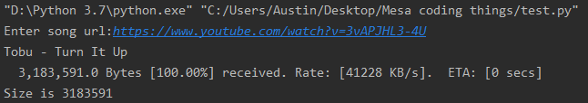
Challenge!!
Use the pafy module to download a video on youtube and then convert it to .webm and save it in your current directory
Use the documentation below to understand how to do it
https://pypi.org/project/pafy/

Slide 17
Thanks!!
Email: ayyen@ucsc.edu

